Slide 1
Group 13: Spatial Models for Species Area Curves

Slide 2
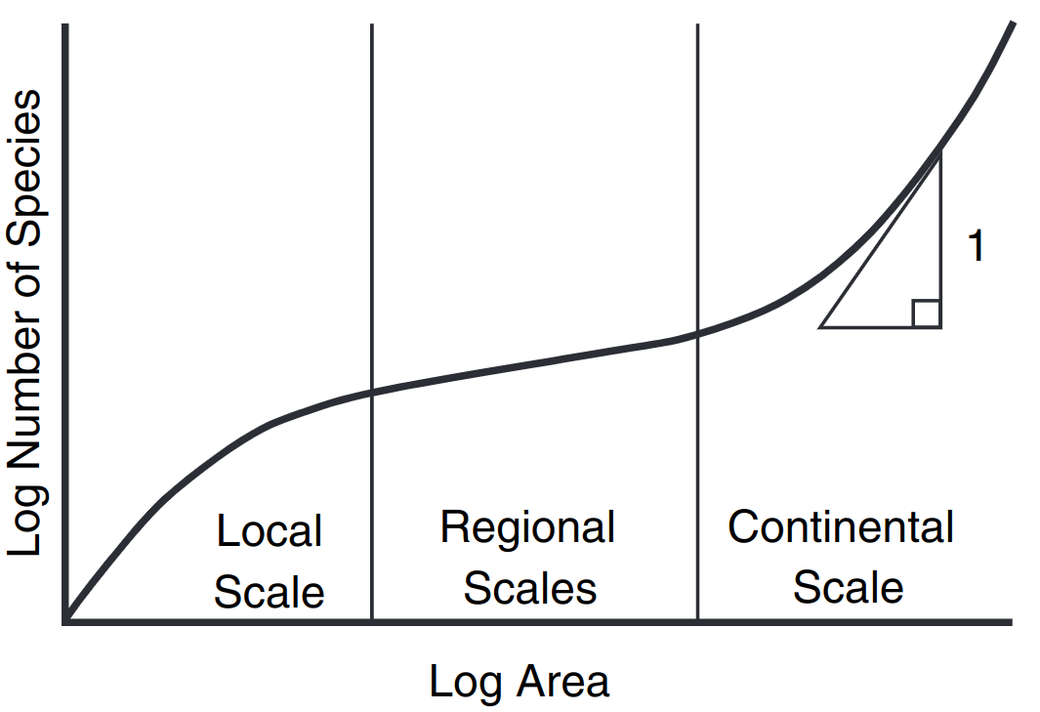
Species Area Curve: power law
Log transformed axes show power law relationship at intermediate scale and global scale
Caveats
Data unreliable
Several fits possible
Rosindell, J. and Cornell, S.J. (2007)

Slide 3
Species Area Curve: Practical Relevance
Comparison of biodiversity in different areas
Reserve design
Predicting species loss due to habitat loss
Dengler, J. (2009)

Slide 4
Research question
What components are necessary to produce the power-law species area curve?
Death
Reproduction
Speciation/migration
How does the way organisms reproduce affect the shape of the species area curve?
Offspring born far away -> more species richness
Offspring born close by -> less species richness

Slide 5
Structure
Basic model
Dispersal kernels
‘Island’ model

Slide 6
Our model
Death
Voter model with mutation
Chave, J. et al. (2002)
Speciation rate ⍺
L x L grid
Simulated backwards in time
Rosindell et. al. (2008)
⍺
1-⍺

Slide 7
Assumptions
No fitness difference between species
No empty spaces in ecosystem simulation
One organism per site
Periodic boundary conditions
Chave, J. et al. (2002)

Slide 8
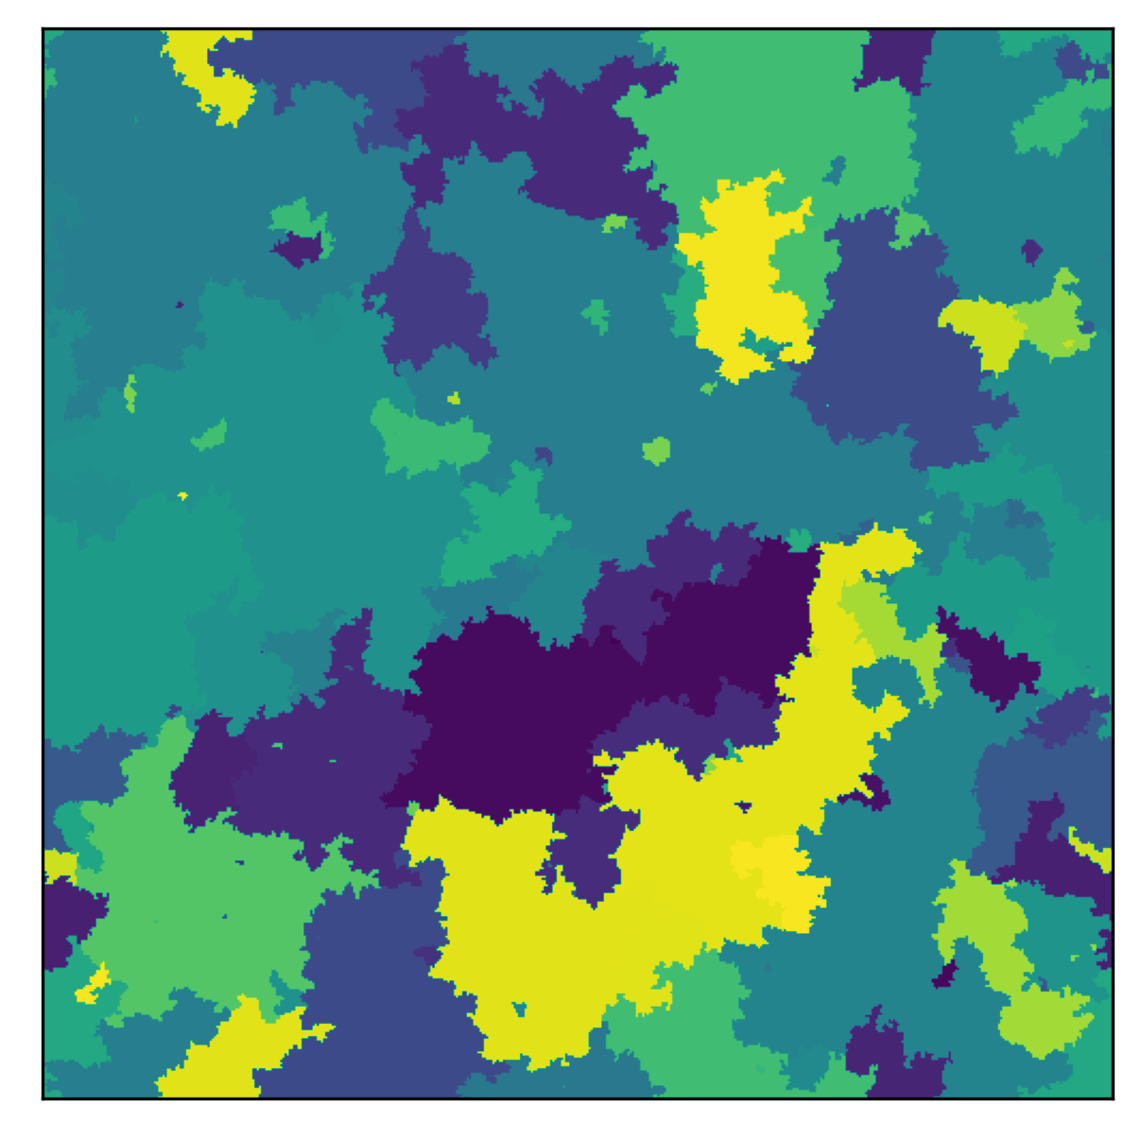
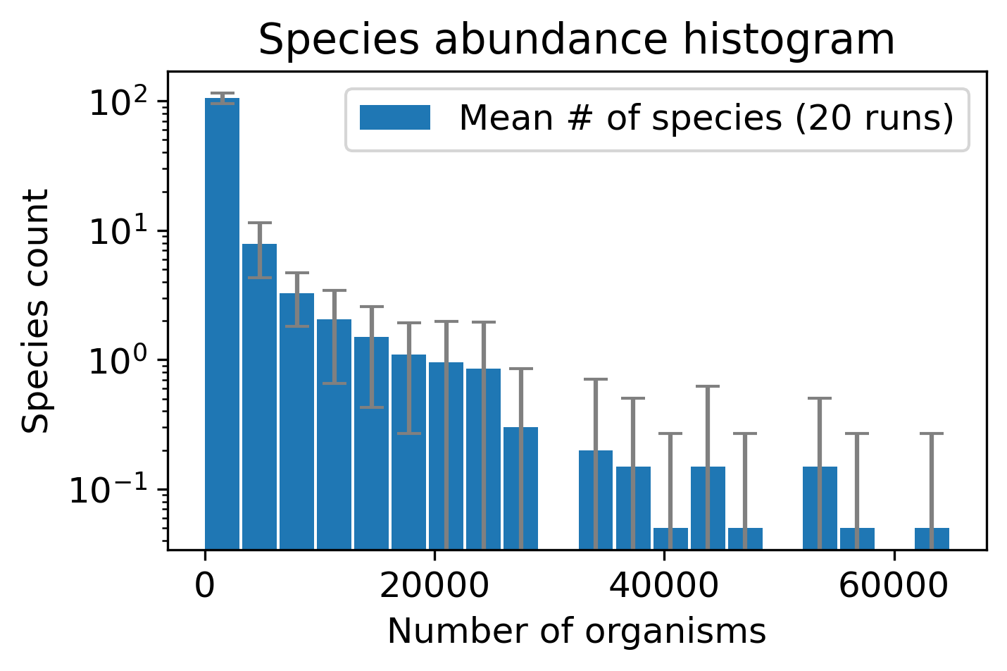
Simulation results
500x500 grid
Nearest neighbor offspring

Slide 9
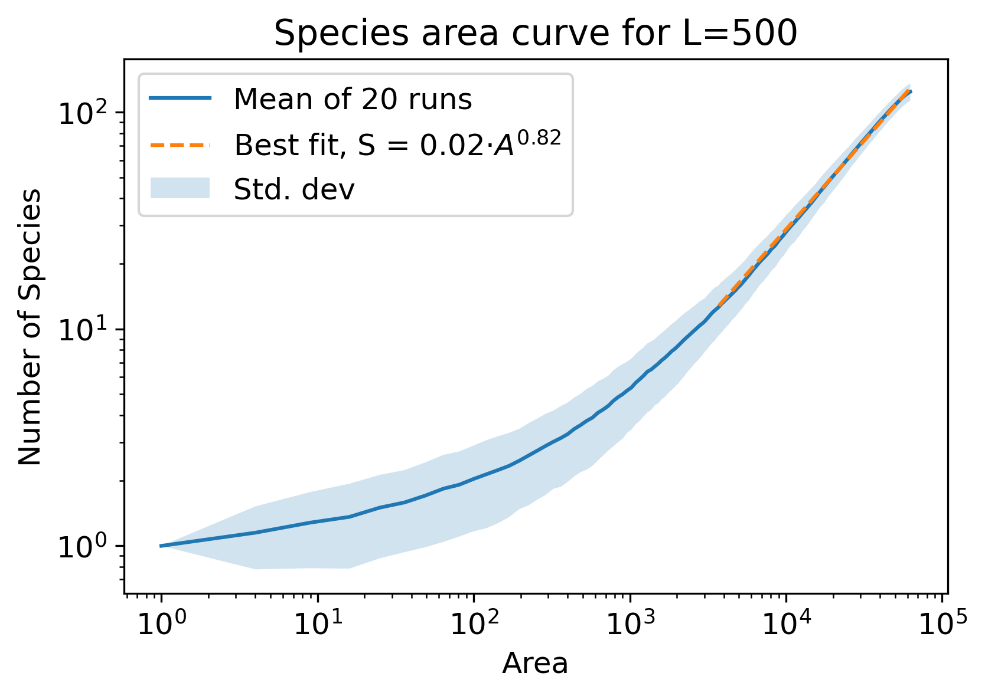
Results: Species area curves
Behaviour depends on scale
Local scale: low slope
Large scale: high slope
Kolmogorov-Smirnov test
p-value of 0.999

Slide 10
Hmmmmm….

Slide 11
Dispersal Kernel
Nearest neighbor (Von Neumann neighborhood)
Fat tail distribution (Moore neighborhood)
Rosindell, J. and Cornell, S.J. (2007)
Notes:
Introduce dispersal kernel

Slide 12
Nearest neighbors (Von Neumann neighborhood)
Consider Von Neumann neighborhood as a site’s nearest neighbors
Random neighbor fills void
Notes:
Describe nearest neighbor kernel

Slide 13
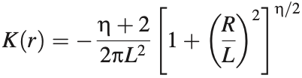
Fat tail (Moore neighborhood)
Neighbor within Moore neighborhood selected with weighted probability fills void
Dispersal kernel
L = kernel width
eta = ‘fatness’ of tail
R and r = distance between parent and offspring
Rosindell, J. and Cornell, S.J. (2009)
Notes:
Describe fat tail distribution kernel

Slide 14
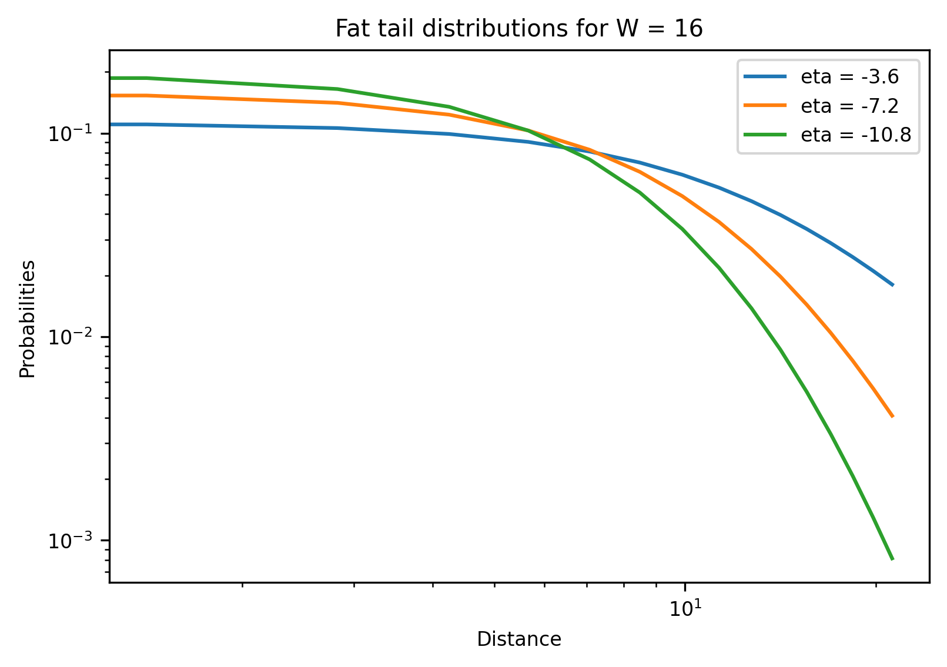
Fat tail distribution
Eta closer to 0 → Fatter tail
Notes:
Higher etas have fatter tails

Slide 15
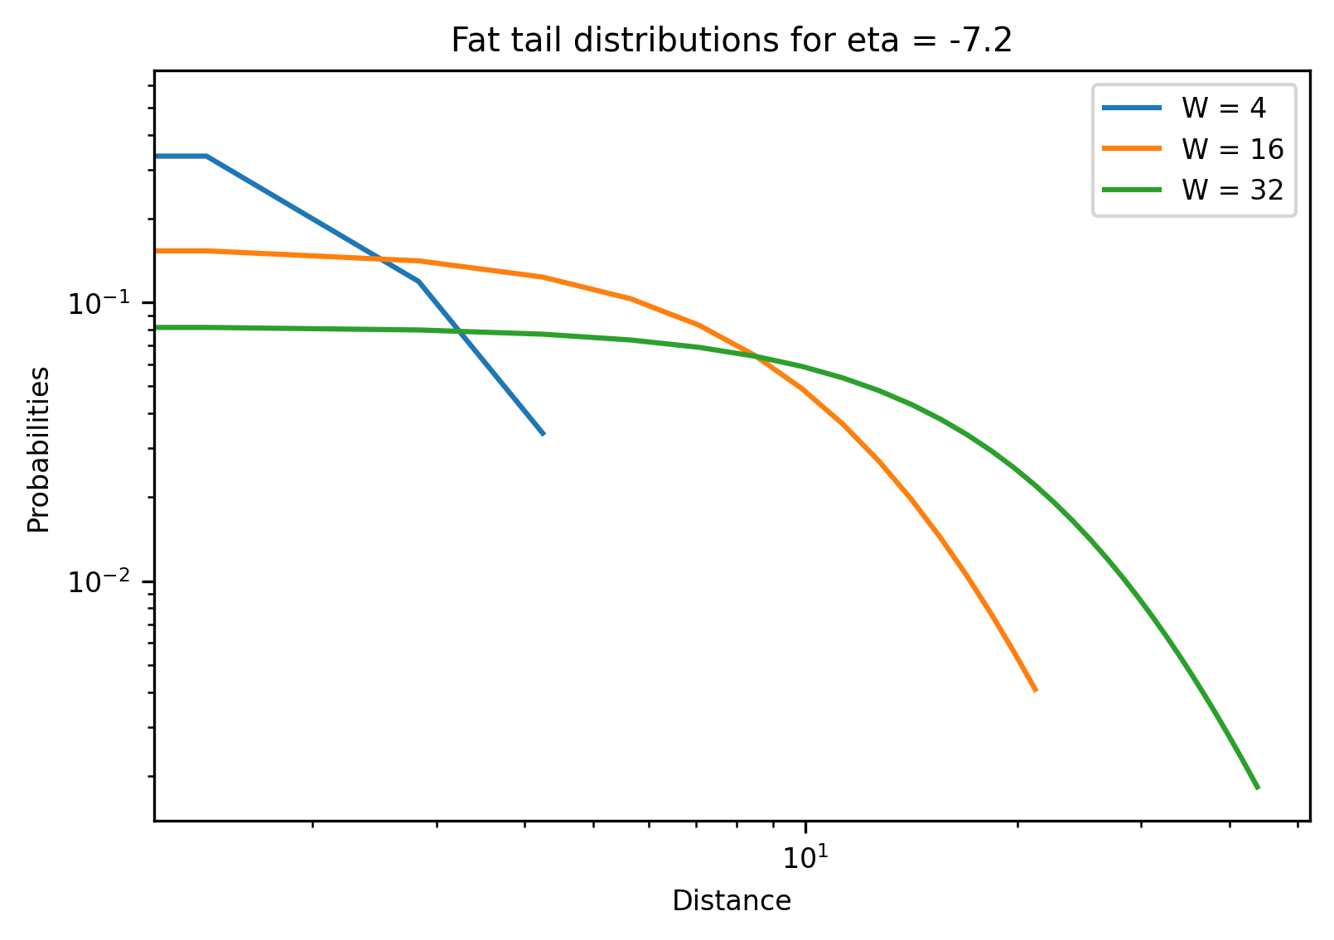
Fat tail distribution
Larger kernel width → Fatter tail
Notes:
Larger kernel widths have fatter tails

Slide 16
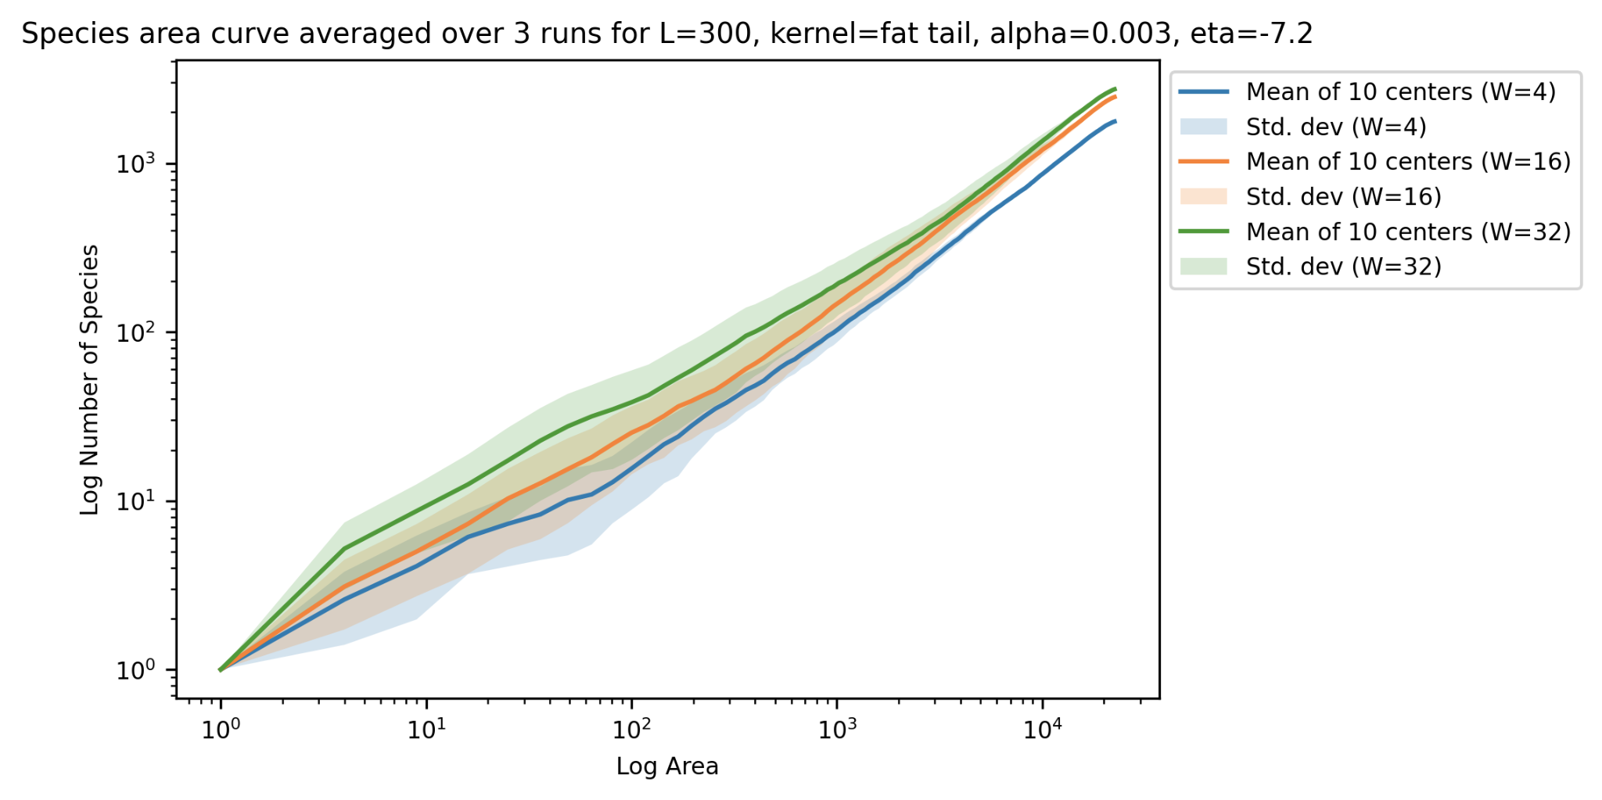
Results simulation fat-tail dispersal kernel (widths)
For:
L = 300
Alpha = 3e-3
Eta = -7.2
Kernel width = [4, 16, 32]
Notes:
Larger kernel width has fatter tail, so it is expected that this curve has more species differentiation

Slide 17
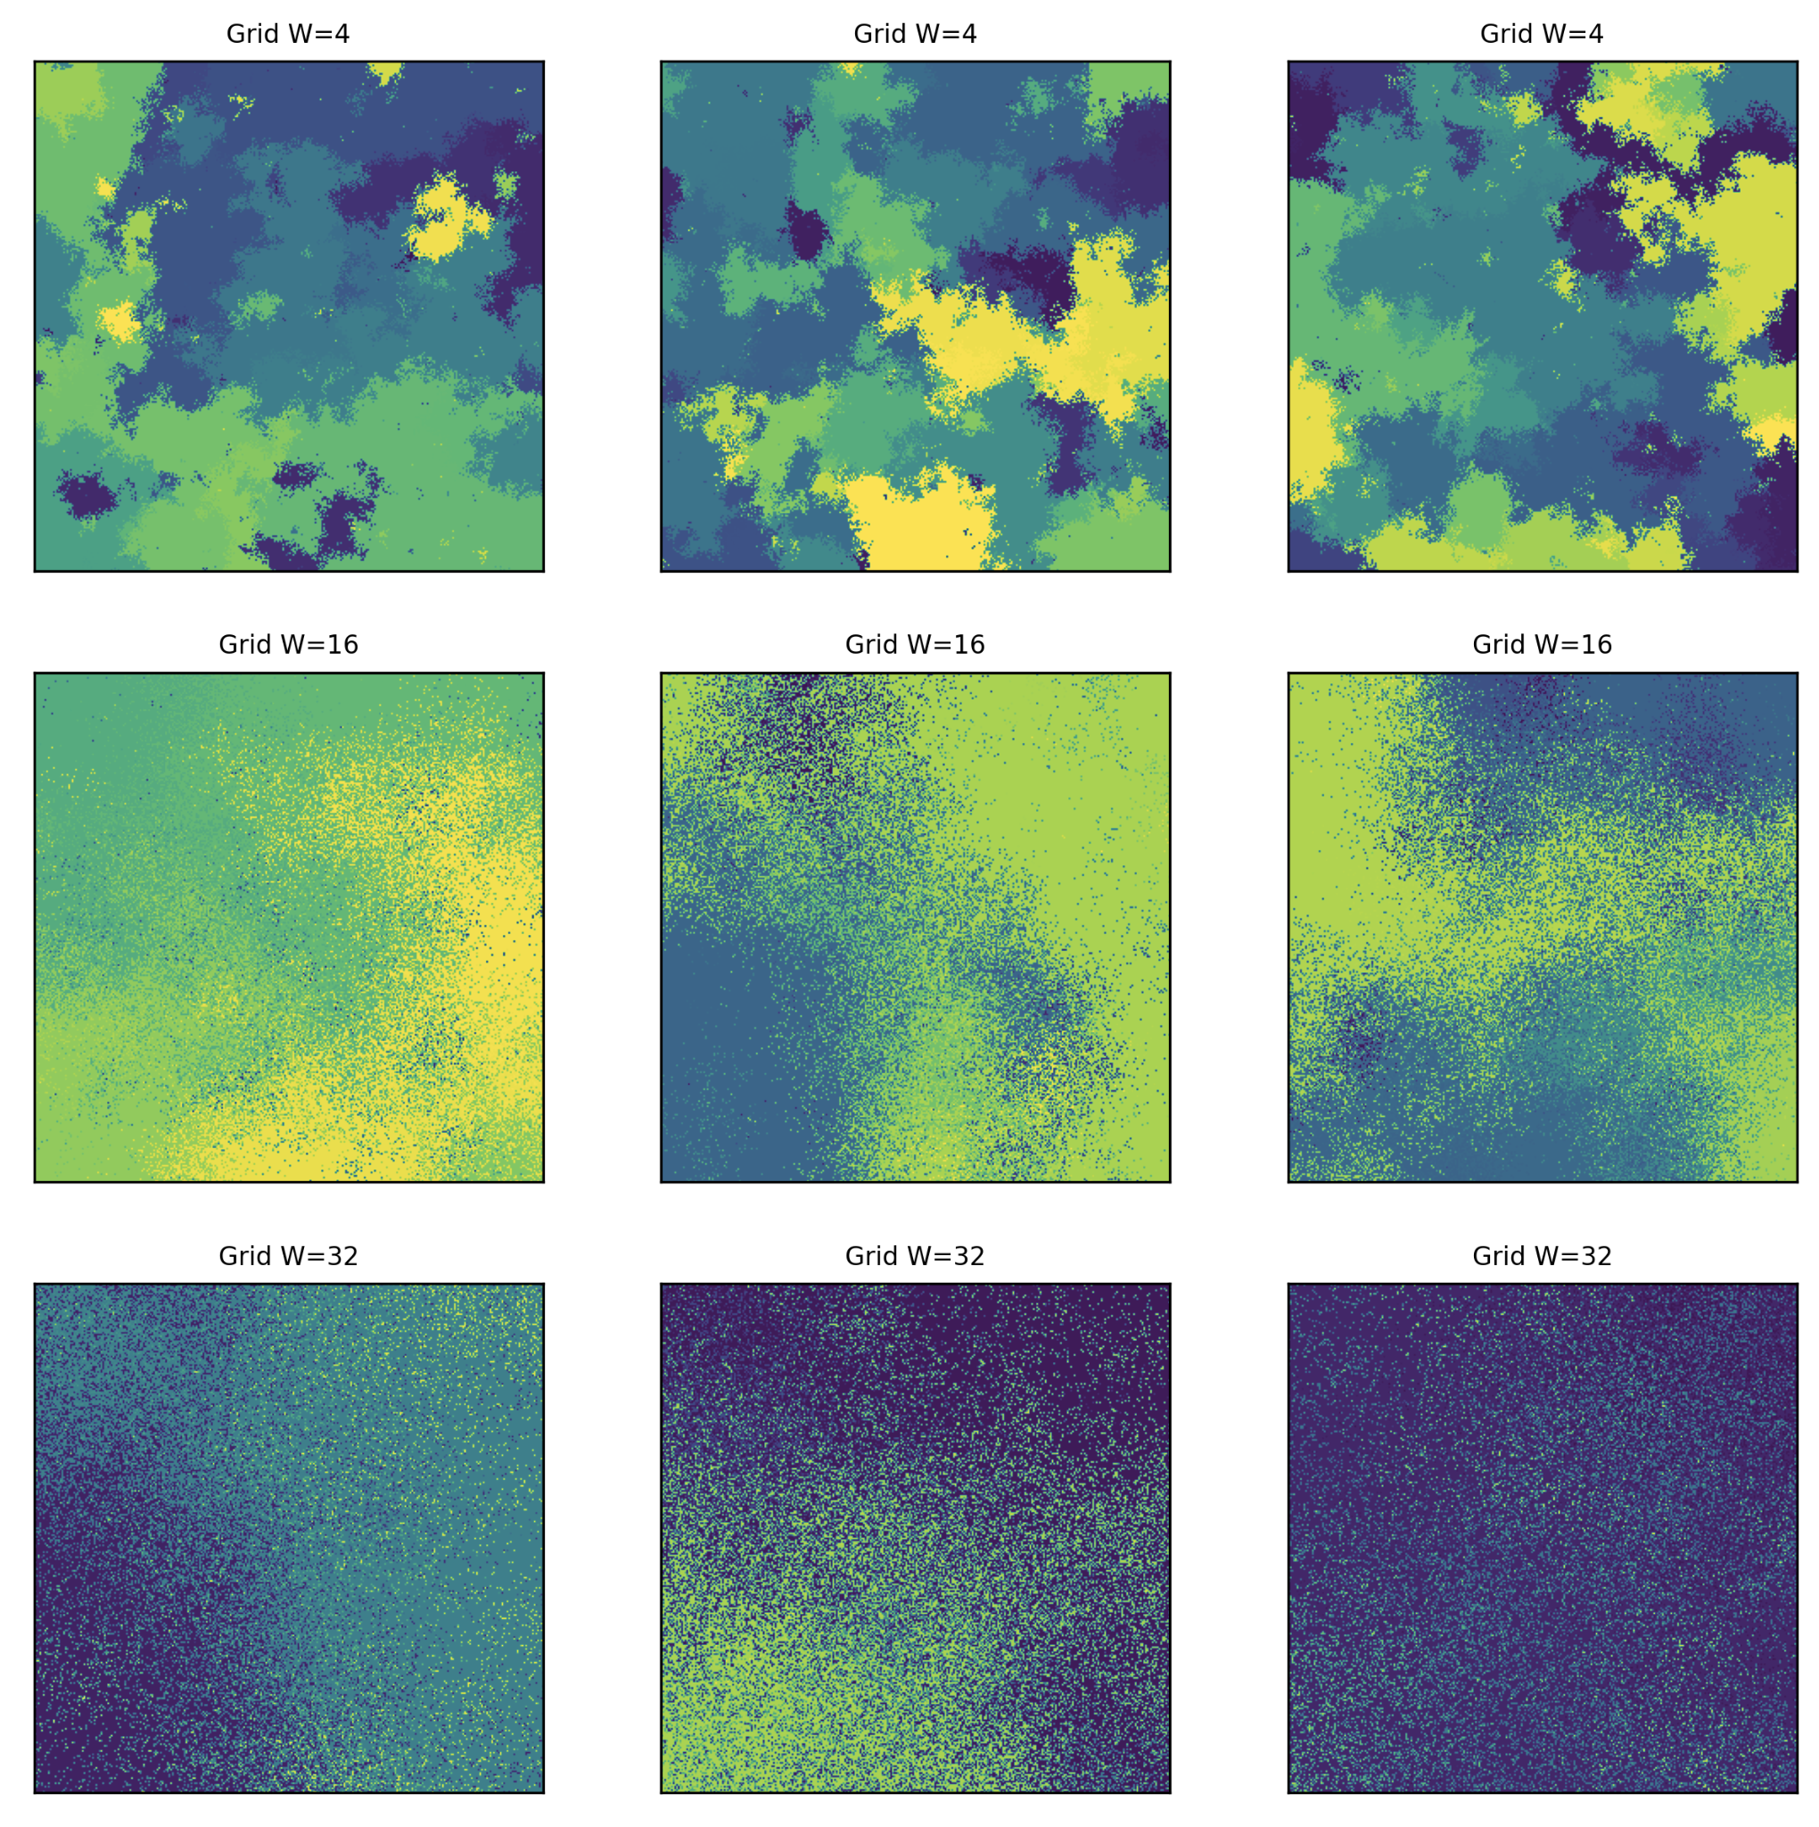
Visualization

Slide 18
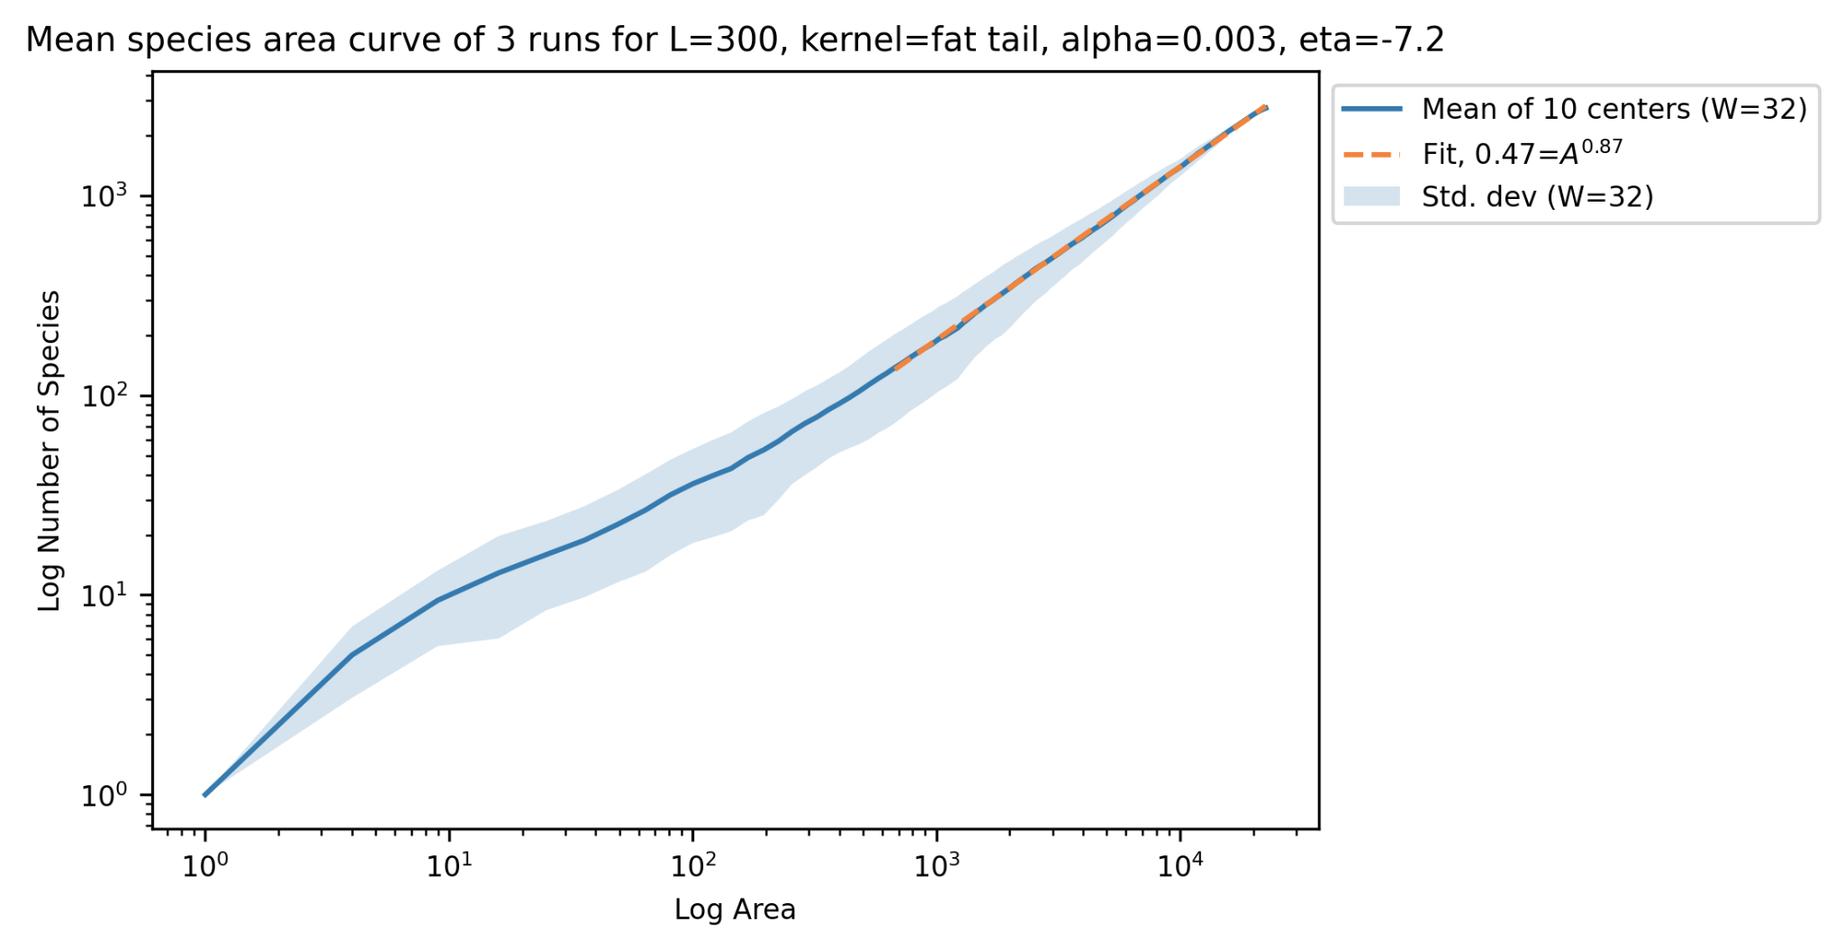
High power law exponent for global scale
Kolmogorov-Smirnov test
P-value = 0.9999
Notes:
Example 1: fitted curve shows high exponent in global scale (z=0.86) near 1

Slide 19
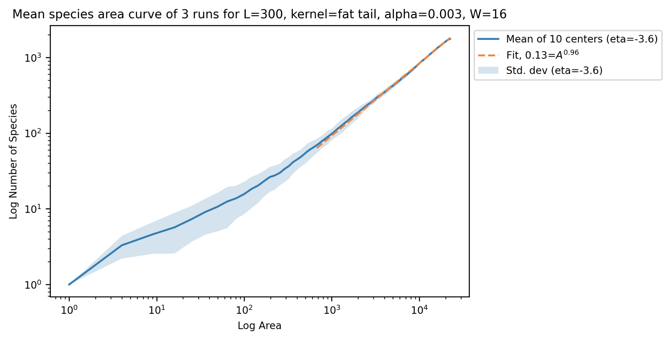
High power law exponent for global scale
Kolmogorov-Smirnov test
P-value = 0.9999
Notes:
Example 2: fitted curve shows high exponent in global scale (z = 0.96) near 1

Slide 20
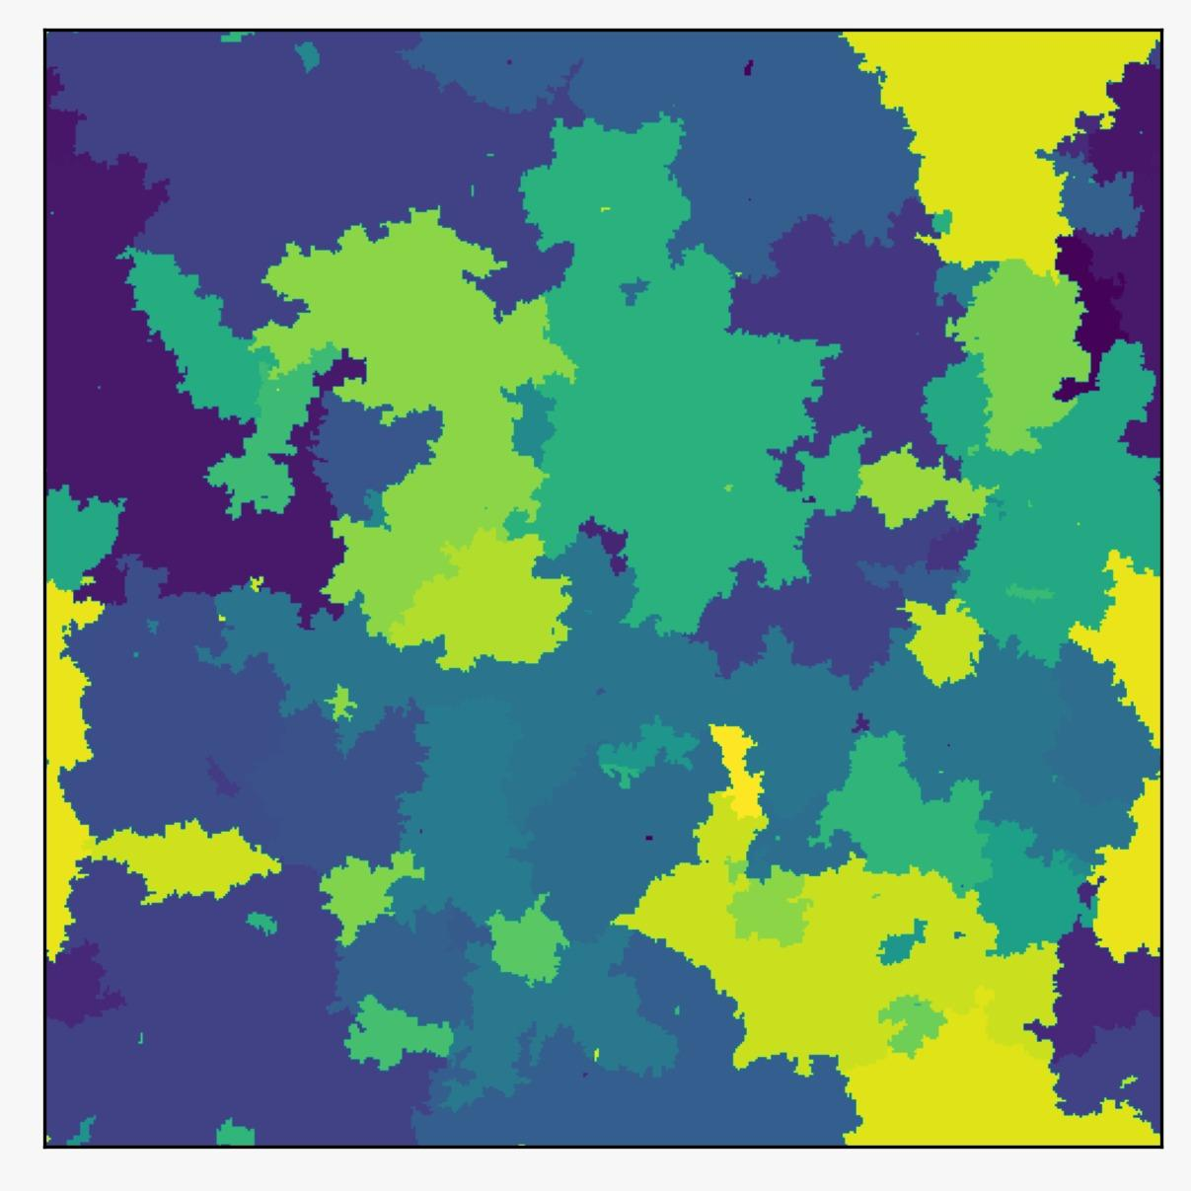
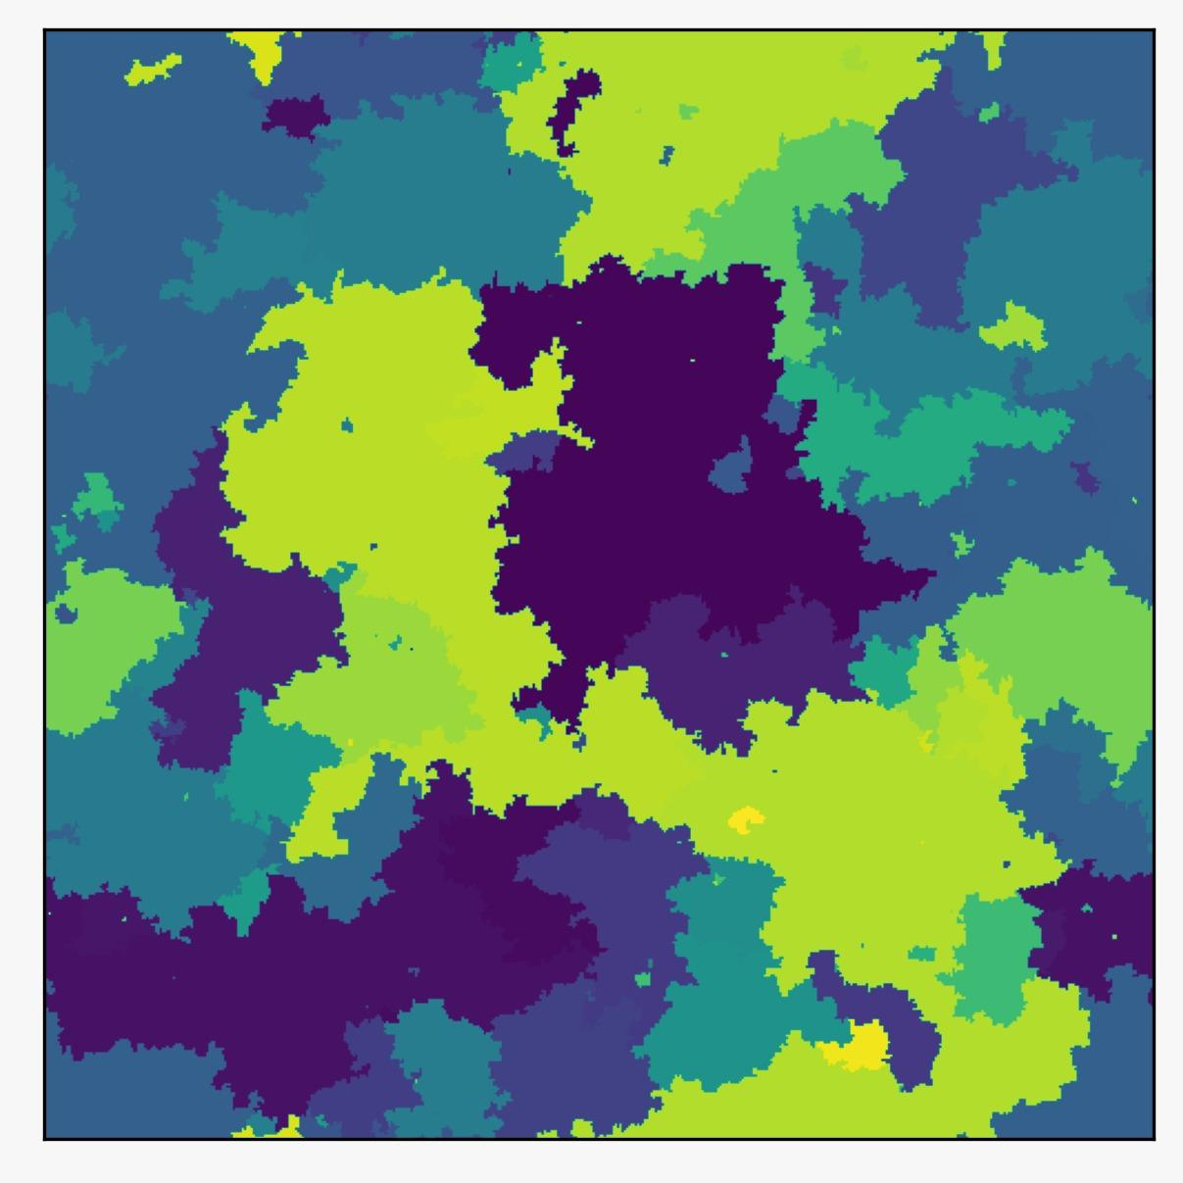
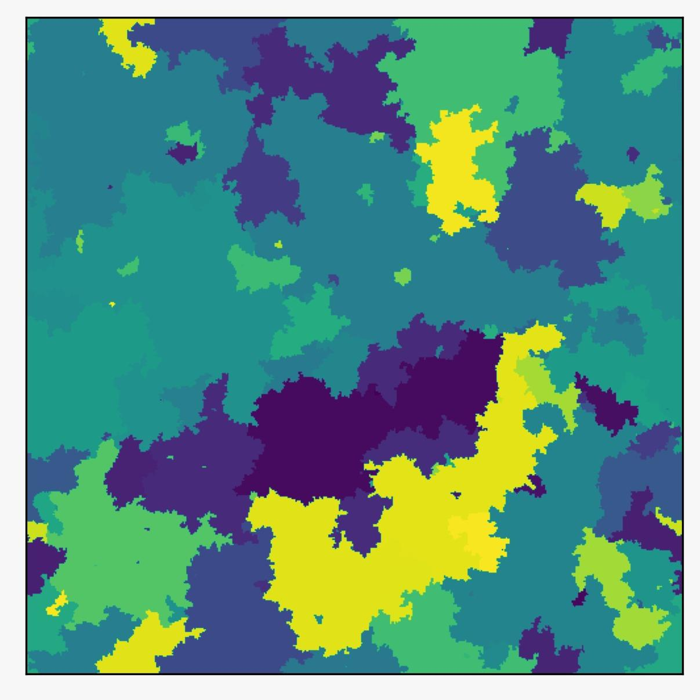
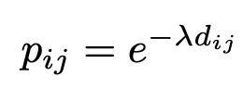
Multiple ‘Islands’
Same underlying assumptions as single grid
Individual dynamics
Von Neumann neighborhood
Migration term
Influence of distance
Experiment with two islands
p

Slide 21
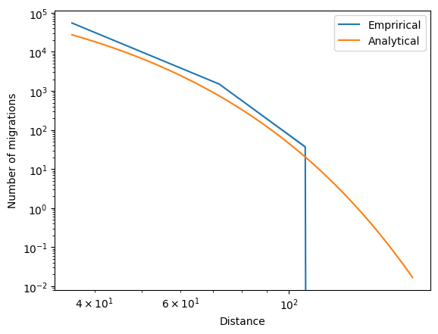
Distance vs migration
Quick decay
Standard Deviation
Four different distances

Slide 22
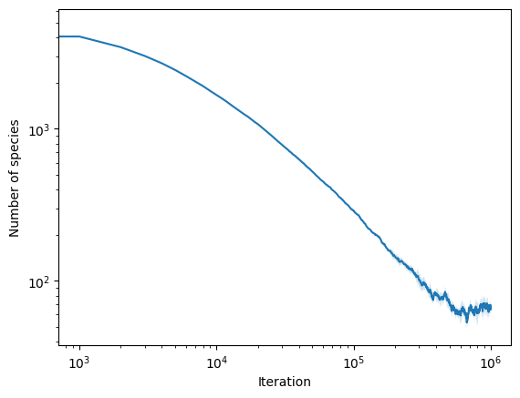
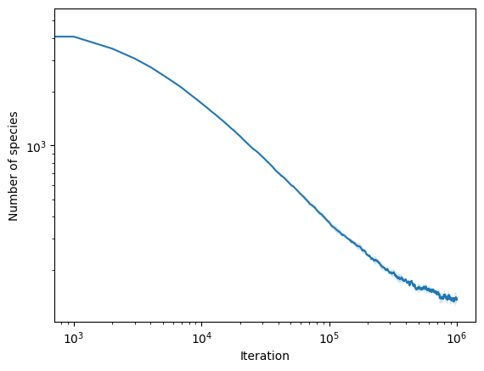
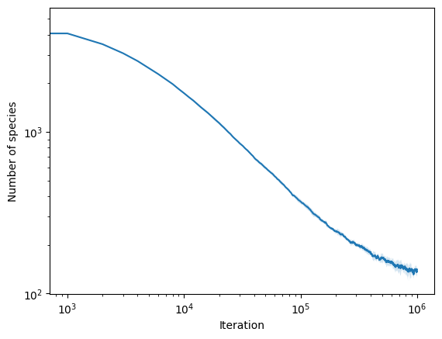
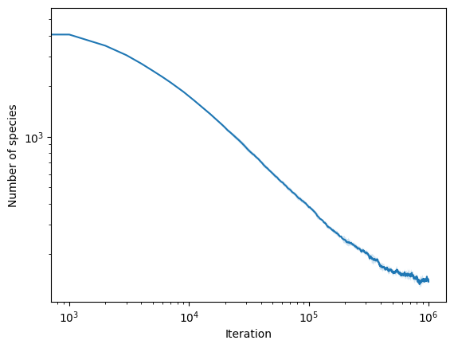
Convergence

Slide 23
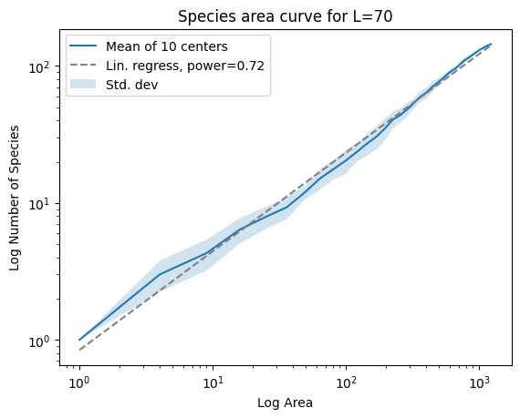
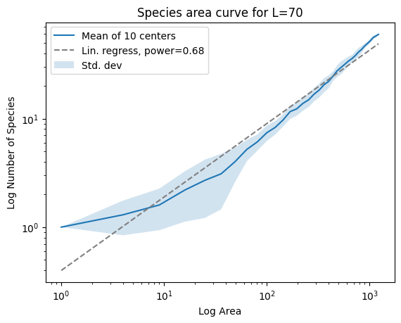
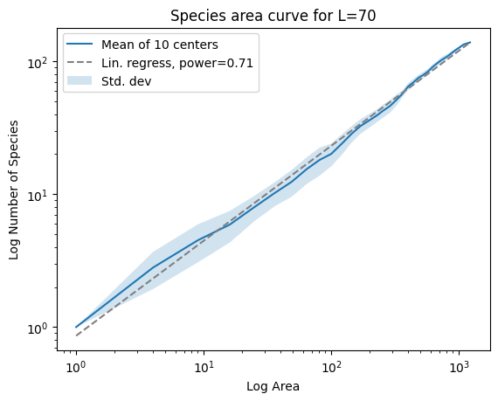
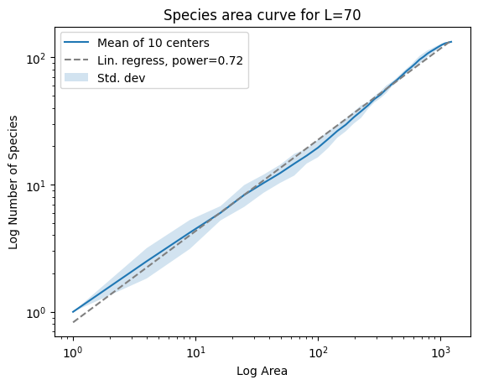
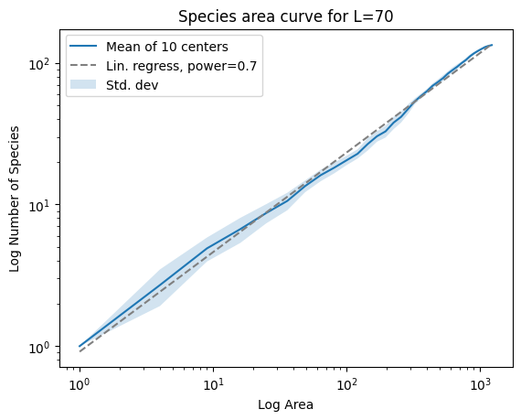
SA Curves

Slide 24
Summary
Voter model with mutation
Explains global scale, not local
Fat-tailed dispersal kernel reproduces true shape
Multiple islands/habitats
More work (iterations) needed

Slide 25
References
Rosindell, J., & Cornell, S. J. (2009). Species–area curves, neutral models, and long‐distance dispersal. Ecology, 90(7), 1743-1750.
Dengler, J. (2009), Which function describes the species–area relationship best? A review and empirical evaluation. Journal of Biogeography, 36: 728-744.
Chave, J. et al. (2002), Comparing Classical Community Models: Theoretical Consequences for Patterns of Diversity. The American Naturalist 2002 159:1, 1-23
Rosindel, J. et al. (2008), A coalescence approach to spatial neutral ecology, Ecological Informatics, Volume 3, Issue 3, 259-271

Slide 26
Appendix

Slide 27
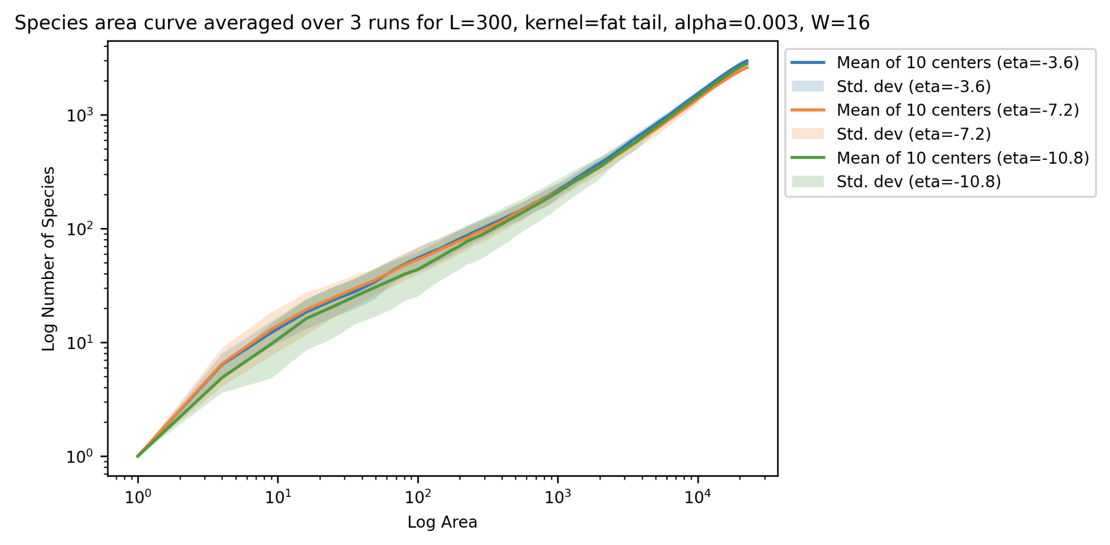
Results simulation fat-tail dispersal kernel (etas)
For:
L = 300
Alpha = 3e-3
Kernel width = 16
Eta = [-3.6, -7.2, -10.8]
Notes:
Eta near 0 has fatter tail, so it is expected that this curve has more species differentiation

